Slide 1
The Impact of God’s Covenant with Abraham
The Age of Promise II

Slide 2
The Pattern of the Ages
How was God worshipped during this time?
What was man’s responsibility during this time?
Who worshipped God and who did not?
How did God keep his promises?

Slide 3
The Story so Far
The knowledge of God was gradually being abandoned by all nations, therefore God blessed Abraham to preserve the hope of salvation for all mankind
God blessed Abraham
  With a multitude of descendants who became the great nation of Israel

Slide 4
The Story so Far
The knowledge of God was gradually being abandoned by all nations, therefore God blessed Abraham to preserve the hope of salvation for all mankind
God blessed Abraham
  With a multitude of descendants
  With the land of Canaan forever
  With great blessing that would flow to all mankind

Slide 5
The Impact of the Abrahamic Covenant
Gen 17; Heb 11; Ps 105; Josh 21; Jer 31; Ezek 47; Rom 11

Slide 6
Worship of the God of Abraham
God would become the God of Abraham and his descendants forever
“And I will establish my covenant between me and you and your offspring after you throughout their generations for an everlasting covenant, to be God to you and to your offspring after you. And I will give to you and to your offspring after you the land of your sojournings, all the land of Canaan, for an everlasting possession, and I will be their God.”” (Genesis 17:7–8, ESV)

Slide 7
Worship of the God of Abraham
God would become the God of Abraham
Some did worship God during the Age of Promise
  A few Gentiles
    Melchizedek Gen 14:18-20
    “And Melchizedek king of Salem brought out bread and wine. (He was priest of God Most High.)” (Genesis 14:18, ESV)
    Job

Slide 8
Worship of the True God
God would become the God of Abraham
Some did worship God during the Age of Promise
  A few Gentiles
  The Patriarchs – Abraham
“By faith Abraham obeyed when he was called to go out to a place that he was to receive as an inheritance. And he went out, not knowing where he was going. By faith he went to live in the land of promise, as in a foreign land, living in tents with Isaac and Jacob, heirs with him of the same promise.” (Hebrews 11:8–9, ESV)

Slide 9
Worship of the God of Abraham
God would become the God of Abraham
Some did worship God during the Age of Promise
  A few Gentiles
  The Patriarchs – Abraham, Isaac, and Jacob
“By faith Isaac invoked future blessings on Jacob and Esau. By faith Jacob, when dying, blessed each of the sons of Joseph, bowing in worship over the head of his staff.” (Hebrews 11:20–21, ESV)

Slide 10
Worship of the God of Abraham
God would become the God of Abraham
Some did worship God during the Age of Promise (Gen 14:18; Heb 11:8-9, 20-23)
  A few Gentiles
  The Patriarchs – Abraham, Isaac, Jacob and Joseph
“By faith Joseph, at the end of his life, made mention of the exodus of the Israelites and gave directions concerning his bones.” (Hebrews 11:22, ESV)

Slide 11
Worship of the God of Abraham
God would become the God of Abraham
Some did worship God during the Age of Promise
  A few Gentiles
  The Patriarchs
  Some Israelites
“By faith Moses, when he was born, was hidden for three months by his parents, because they saw that the child was beautiful, and they were not afraid of the king’s edict.” (Heb 11:23, ESV)

Slide 12
Worship of the God of Abraham
God would become the God of Abraham
Some did worship God during the Age of Promise
Many did not worship God during the Age of Promise
  Most nations worshiped Idols
“In past generations he allowed all the nations to walk in their own ways.” (Acts 14:16, ESV)

Slide 13
Worship of the God of Abraham
God would become the God of Abraham
Some did worship God during the Age of Promise
Many did not worship God during the Age of Promise
  Most nations worshiped Idols
  Many Israelites also worshiped Idols

Slide 14
Many Israelites Also Worshiped Idols
“Did you bring to me sacrifices and offerings during the forty years in the wilderness, O house of Israel? You shall take up Sikkuth your king, and Kiyyun your star-god—your images that you made for yourselves,” (Amos 5:25–26, ESV)

Slide 15
Past fulfillment of the Covenant
God blessed Abraham
“The Lord has greatly blessed my master, and he has become great. He has given him flocks and herds, silver and gold, male servants and female servants, camels and donkeys. And Sarah my master’s wife bore a son to my master when she was old, and to him he has given all that he has.” (Genesis 24:35–36, ESV)

Slide 16
Past fulfillment of the Covenant
God blessed Abraham
God blessed or curse others based on their treatment of Abraham [c.f. Gen 12; 20; 26]
“When they [Patriarchs] were few in number, of little account, and sojourners in it, wandering from nation to nation, from one kingdom to another people, he allowed no one to oppress them; he rebuked kings on their account, saying, “Touch not my anointed ones, do my prophets no harm!”” (Psalm 105:12–15, ESV)
Notes:
Abraham lied about his marriage and nearly lost Sarah twice, and Isaac nearly lost Rebecca once for the same lie [Gen 12:10-20; 20:1-18; 26:7-11]

Slide 17
Past fulfillment of the Covenant
God blessed Abraham
God blessed or curse others based on their treatment of Abraham
God multiplied Abraham and made a great nation out of him
“But the people of Israel were fruitful and increased greatly; they multiplied and grew exceedingly strong, so that the land was filled with them.” (Exodus 1:7, ESV)

Slide 18
Past fulfillment of the Covenant
God blessed Abraham
God blessed or curse others based on their treatment of Abraham
God multiplied Abraham and made a great nation out of him
God gave the land of Canaan to the Israelites

Slide 19
God gave the land of Canaan
“Thus the Lord gave to Israel all the land that he swore to give to their fathers. And they took possession of it, and they settled there. And the Lord gave them rest on every side just as he had sworn to their fathers. Not one of all their enemies had withstood them, for the Lord had given all their enemies into their hands. Not one word of all the good promises that the Lord had made to the house of Israel had failed; all came to pass.” (Joshua 21:43–45, ESV)

Slide 20
Past fulfillment of the Covenant
God blessed Abraham
God blessed or curse others based on their treatment of Abraham
God multiplied Abraham and made a great nation out of him
God gave the land of Canaan to the Israelites
God send Jesus the Son of Abraham to bless the world

Slide 21
God send Jesus the Son of Abraham to bless the world
“And the Scripture, foreseeing that God would justify the Gentiles by faith, preached the gospel beforehand to Abraham, saying, “In you shall all the nations be blessed.” (Galatians 3:8, ESV)
“Christ redeemed us from the curse of the law by becoming a curse for us—for it is written, “Cursed is everyone who is hanged on a tree”— so that in Christ Jesus the blessing of Abraham might come to the Gentiles, so that we might receive the promised Spirit through faith.” (Galatians 3:13–14, ESV)

Slide 22
Continued Fulfillment of the Covenant
Israel’s continued existence as a nation
“And I will establish my covenant between me and you and your offspring after you throughout their generations for an everlasting covenant, to be God to you and to your offspring after you.” (Genesis 17:7, ESV)

Slide 23
Continued Fulfillment of the Covenant
Israel’s continued existence as a nation
“Thus says the Lord, who gives the sun for light by day and the fixed order of the moon and the stars for light by night, who stirs up the sea so that its waves roar— the Lord of hosts is his name: “If this fixed order departs from before me, declares the Lord, then shall the offspring of Israel cease from being a nation before me forever.” Thus says the Lord: “If the heavens above can be measured, and the foundations of the earth below can be explored, then I will cast off all the offspring of Israel for all that they have done, declares the Lord.”” (Jeremiah 31:35–37, ESV)

Slide 24
Continued Fulfillment of the Covenant
Israel’s continued existence as a nation
Israel’s complete possession of the land forever
“And I will give to you and to your offspring after you the land of your sojournings, all the land of Canaan, for an everlasting possession, and I will be their God.”” (Genesis 17:8, ESV)

Slide 25
Continued Fulfillment of the Covenant
Israel’s continued existence as a nation
Israel’s complete possession of the land forever

Slide 26
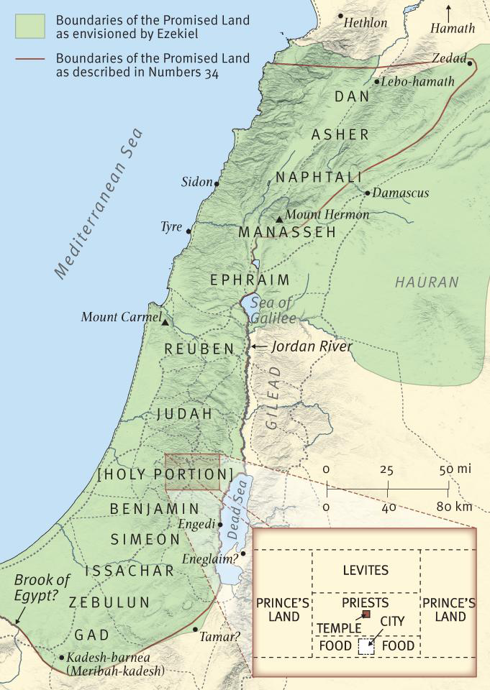
Israel’s Complete Possession of the Land Forever
“Thus says the Lord God: “This is the boundary by which you shall divide the land for inheritance among the twelve tribes of Israel.... And you shall divide equally what I swore to give to your fathers. This land shall fall to you as your inheritance.” (Ezek 47:13–14)

Slide 27
Continued Fulfillment of the Covenant
Israel’s continued existence as a nation
Israel’s complete possession of the land forever
Israel restored will bring even greater blessing for the world

Slide 28
Israel restored will bring even greater blessing for the world
“So I ask, did they [Israel] stumble in order that they might fall? By no means! Rather through their trespass salvation has come to the Gentiles, so as to make Israel jealous. Now if their trespass means riches for the world, and if their failure means riches for the Gentiles, how much more will their full inclusion mean!” (Romans 11:11–12, ESV)

Slide 29
Israel restored will bring even greater blessing for the world
“Now I am speaking to you Gentiles. Inasmuch then as I am an apostle to the Gentiles, I magnify my ministry in order somehow to make my fellow Jews jealous, and thus save some of them. For if their rejection means the reconciliation of the world, what will their acceptance mean but life from the dead?” (Romans 11:13–15, ESV)

